Slide 1
Project “700”: New Life for DCC
First International DCC Convention Eindhoven 2019 Jac Goudsmit

Slide 2

Jac Goudsmit
Eindhoven

Slide 3
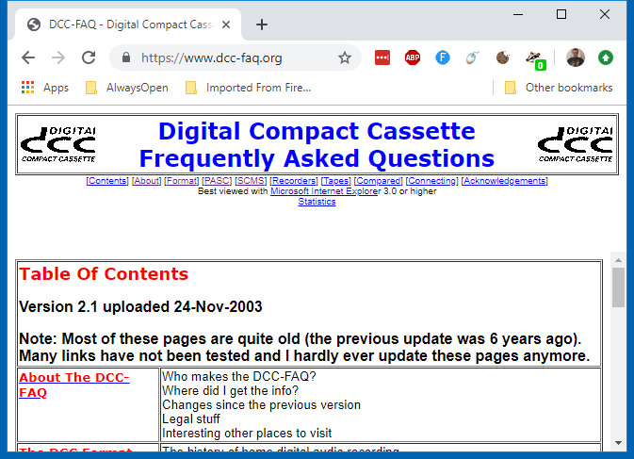
Jac Goudsmit
Eindhoven
DCC-FAQ

Slide 4
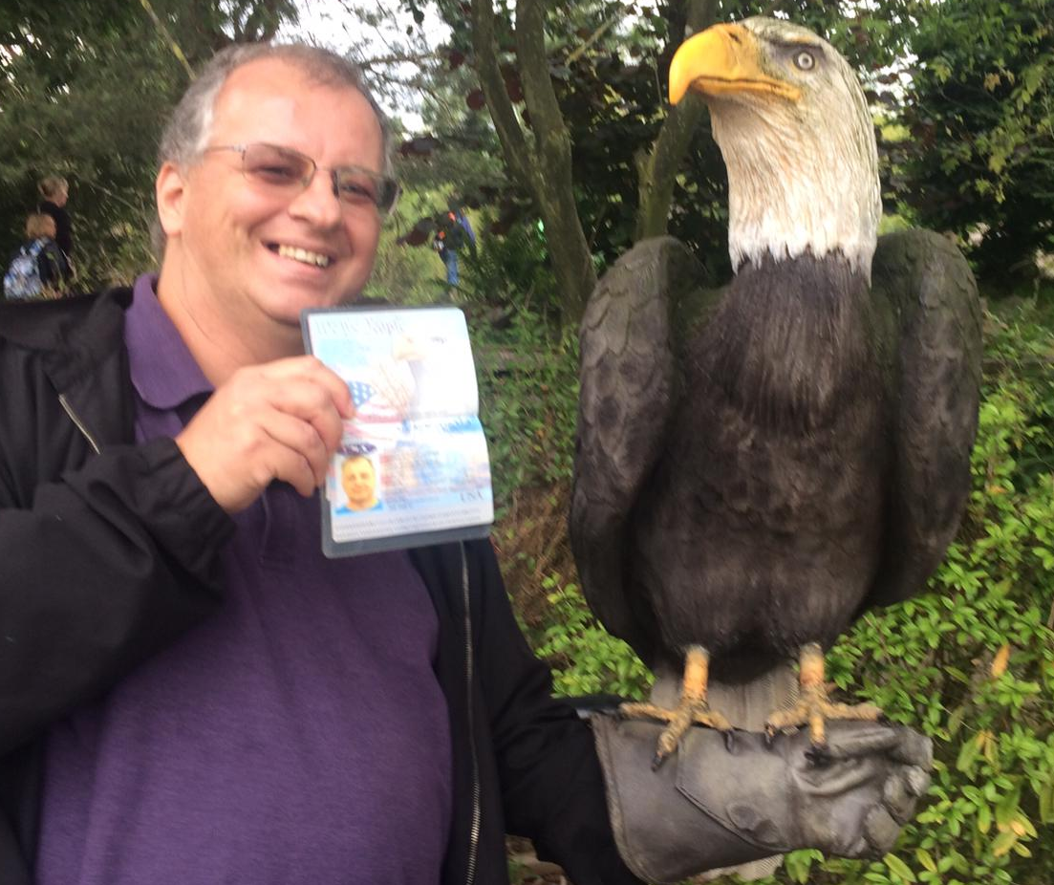
Jac Goudsmit
Eindhoven
DCC-FAQ
USA

Slide 5
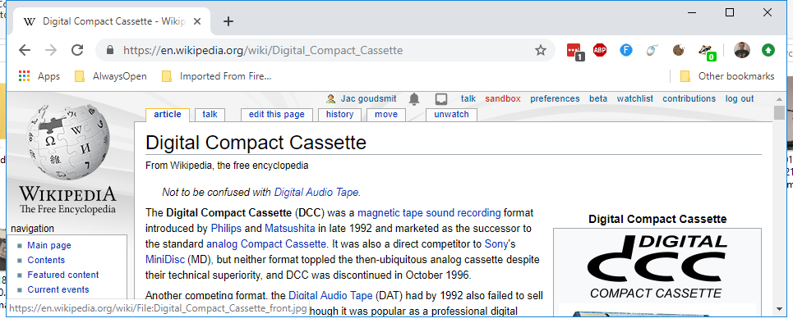
Jac Goudsmit
Eindhoven
DCC-FAQ
USA
Wikipedia

Slide 6
Project “700” Goals
Fix the Fails!

Slide 7
DCC Features Compared
Prerecorded DCC
User Recorded DCC
Search by Track Title
Player Knows What’s on B Side
ITTS Information
Track Titles on 3rd Gen Only
Search by Track Number Only

Slide 8
What User-Recorded DCC Can’t Do
Titles from 3G Recorders Not Visible on Earlier Recorders
No Recorders Have an ITTS Decoder
Only DCC-175 Can Record Titles “On The Fly”
Text Data from Prerecorded DCC’s Can’t Be Archived
Creating Prerecorded Tapes Is Impossible

Slide 9
DCC Overview
From the Perspective of a Power User / Hacker

Slide 10
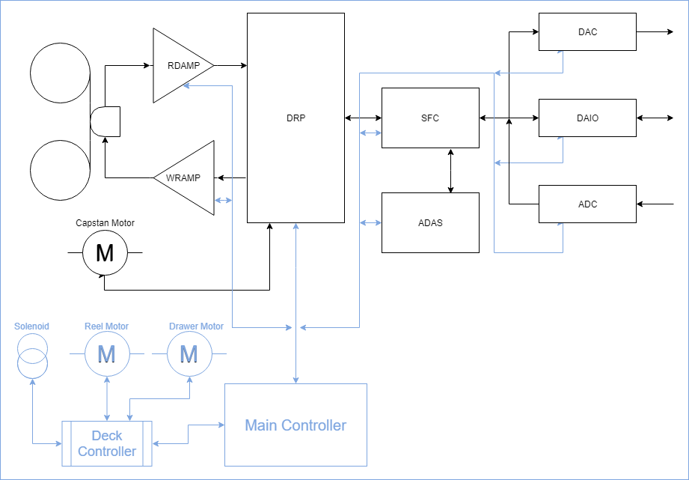
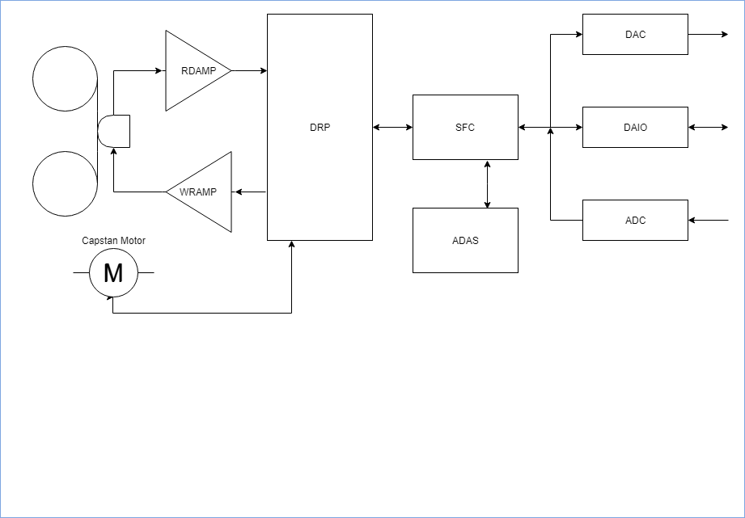
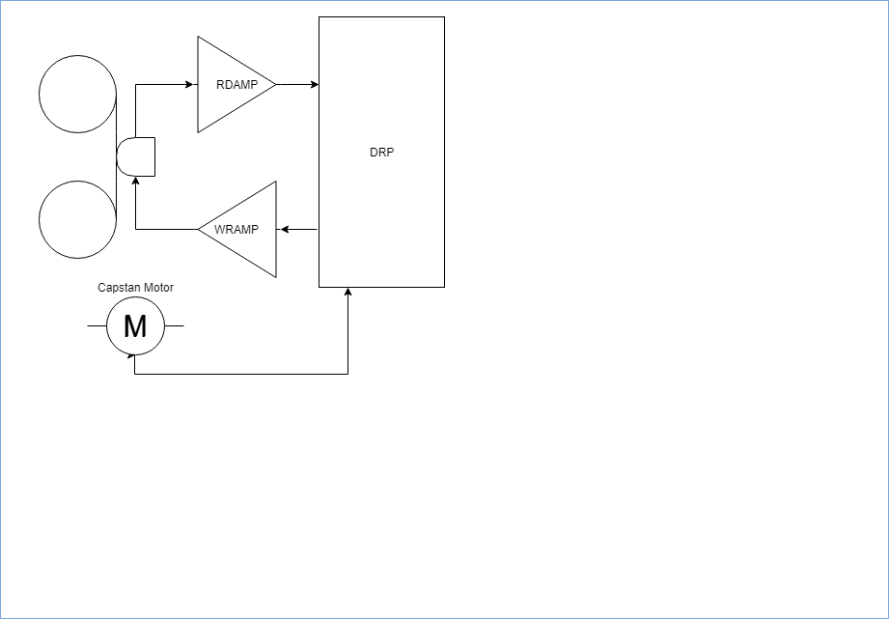

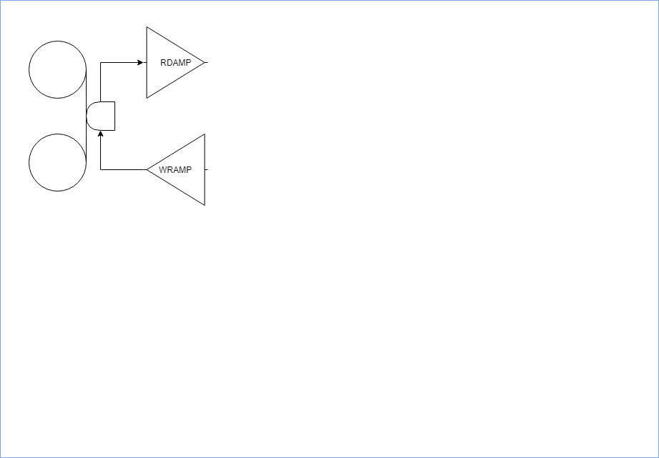
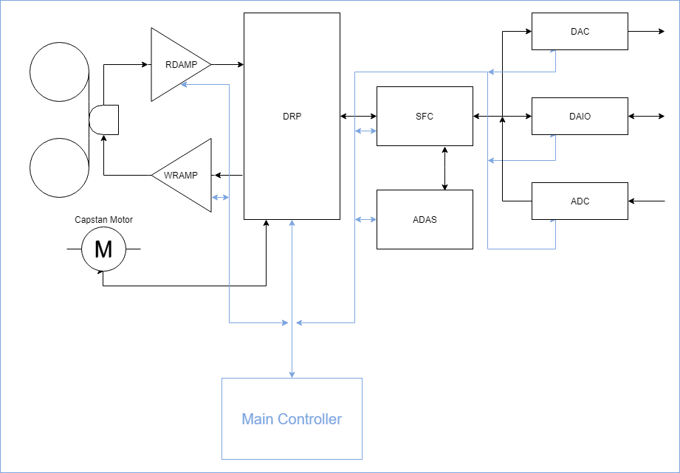
DCC Recorder Architecture (3rd Generation)
Head Assembly
Read/Write Amplifiers
Drive Processor
PASC Codec
Controller
Deck Controller

Slide 11

Teaching a DCC Recorder New Tricks
Everything that gets stored on tape is controlled by the DRP
Everything the DRP does is controlled by the Main Controller
Replace The Main Controller
Bad Idea!

Slide 12
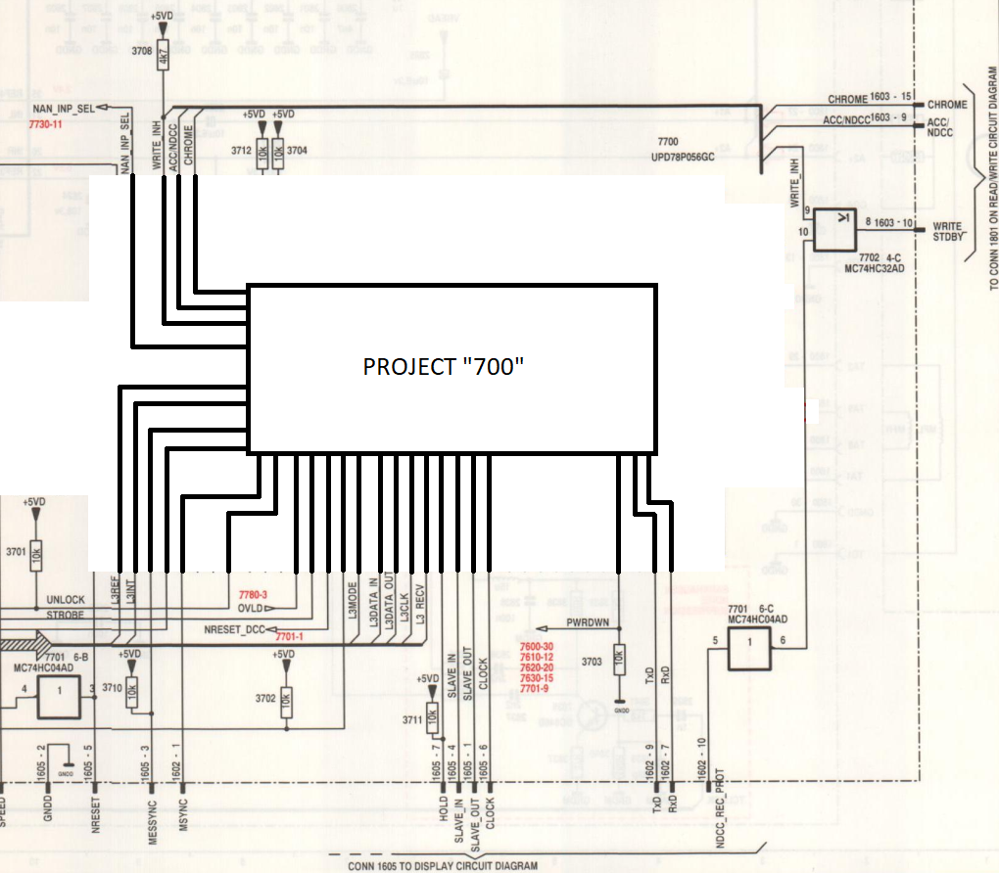
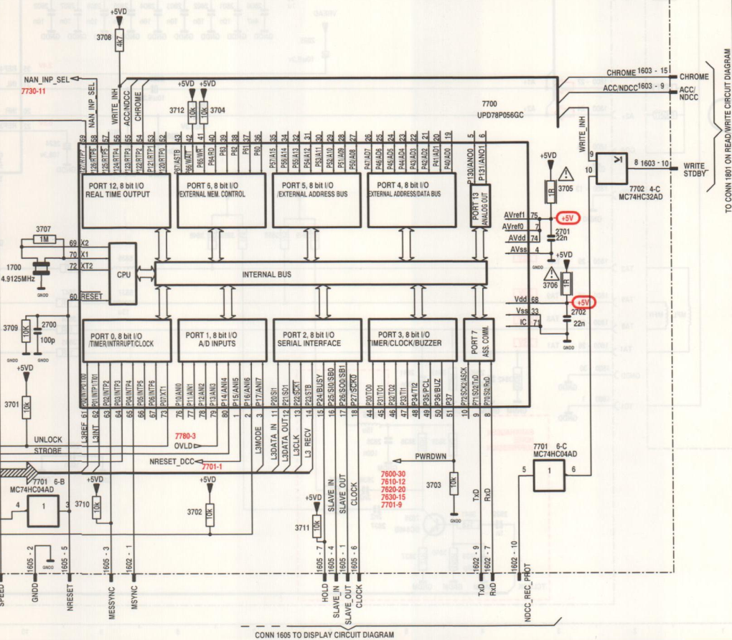
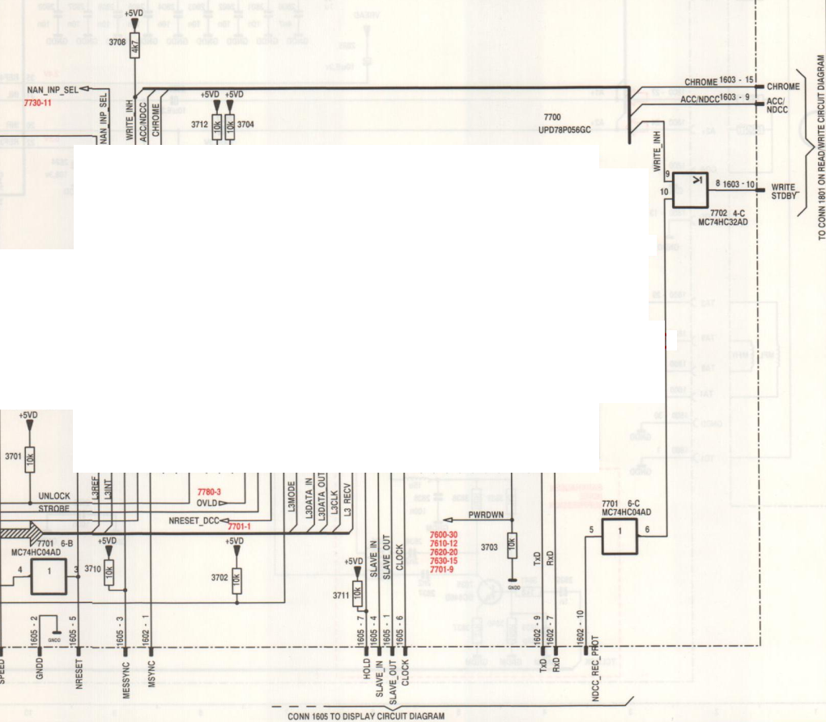

Sleep, Data!
Need L3 Bus to Control the DRP
Main Controller Needs to Be Gone
Challenge!
Put It To Sleep
Take Over

Slide 13
What’s Next?
What I’ve Done So Far And Where I’m Going Next

Slide 14
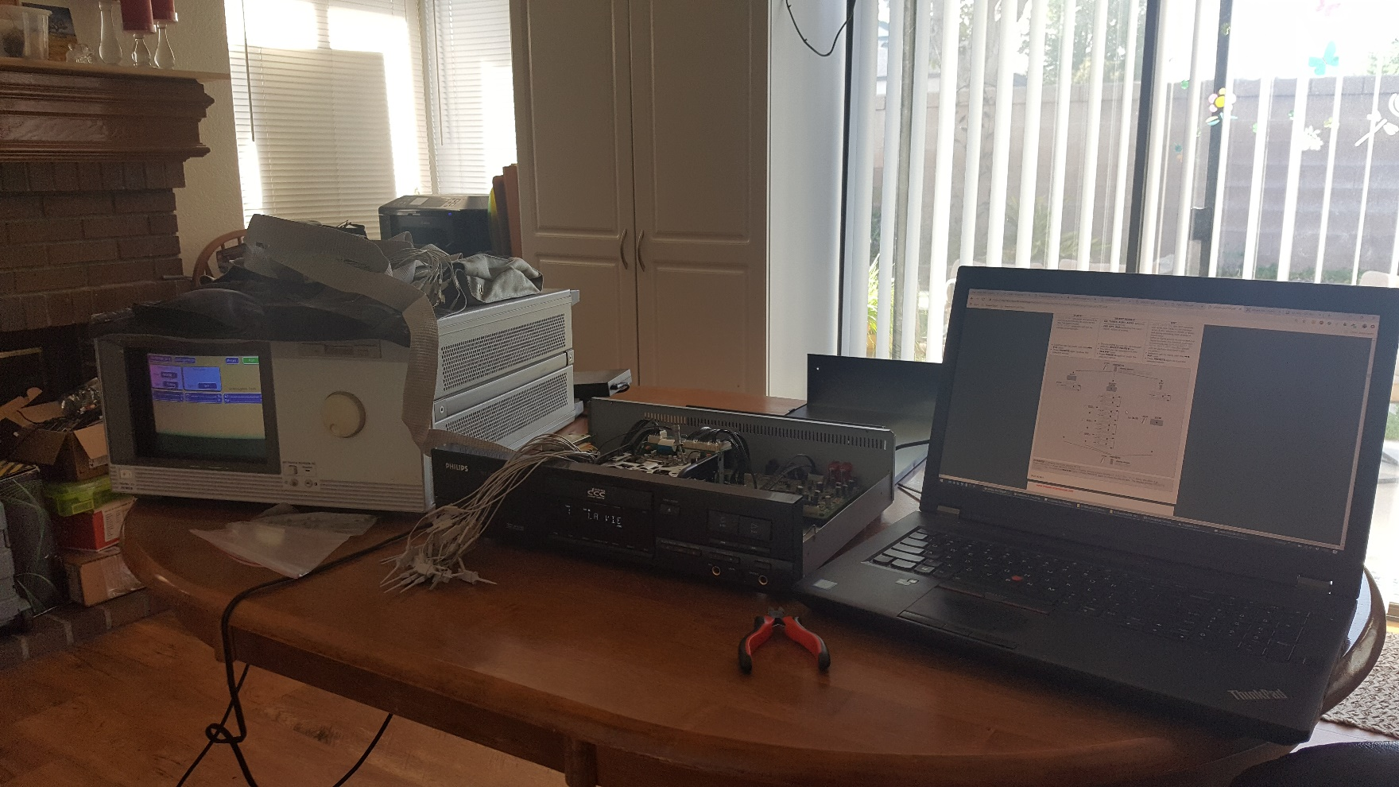
Current Status
Logic Analyzer

Slide 15
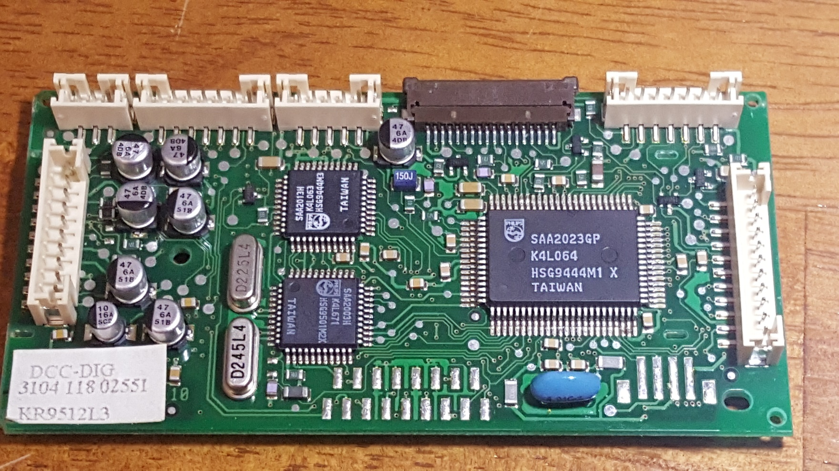
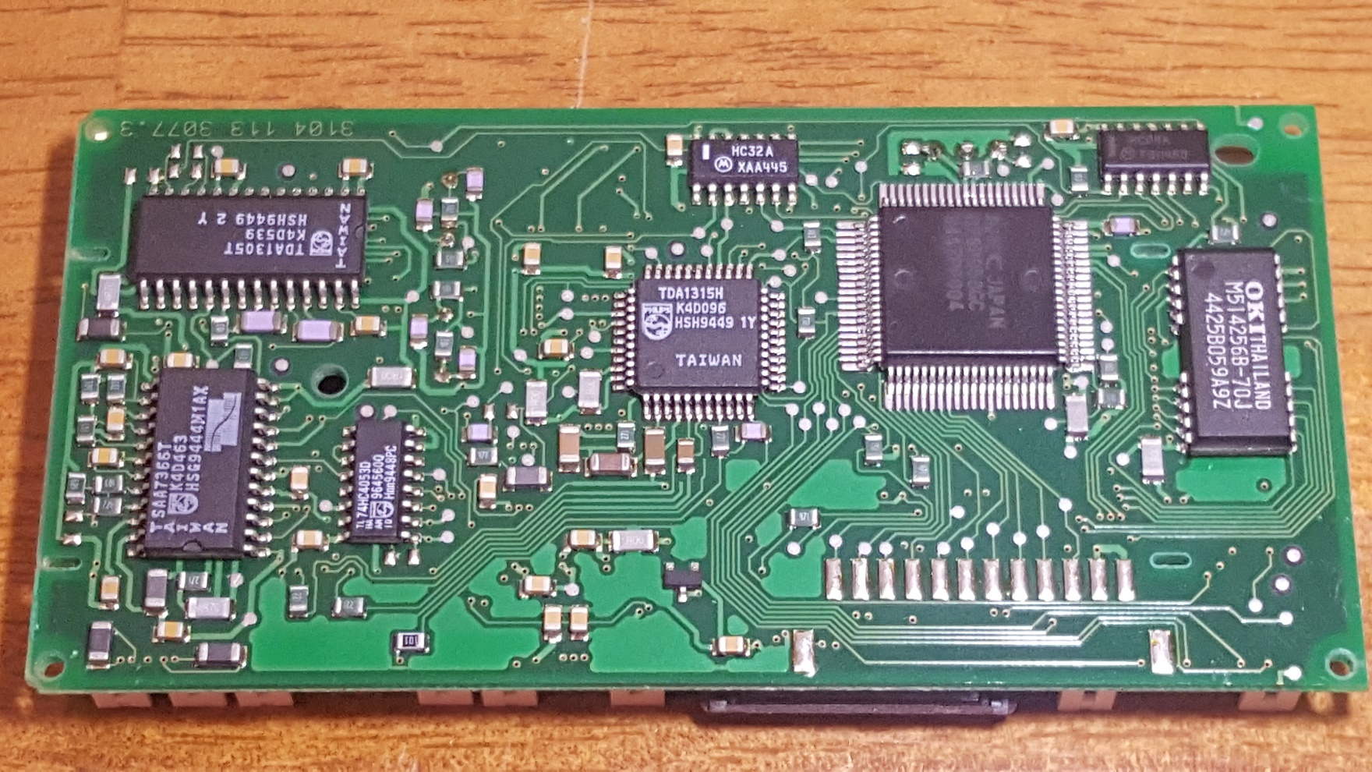
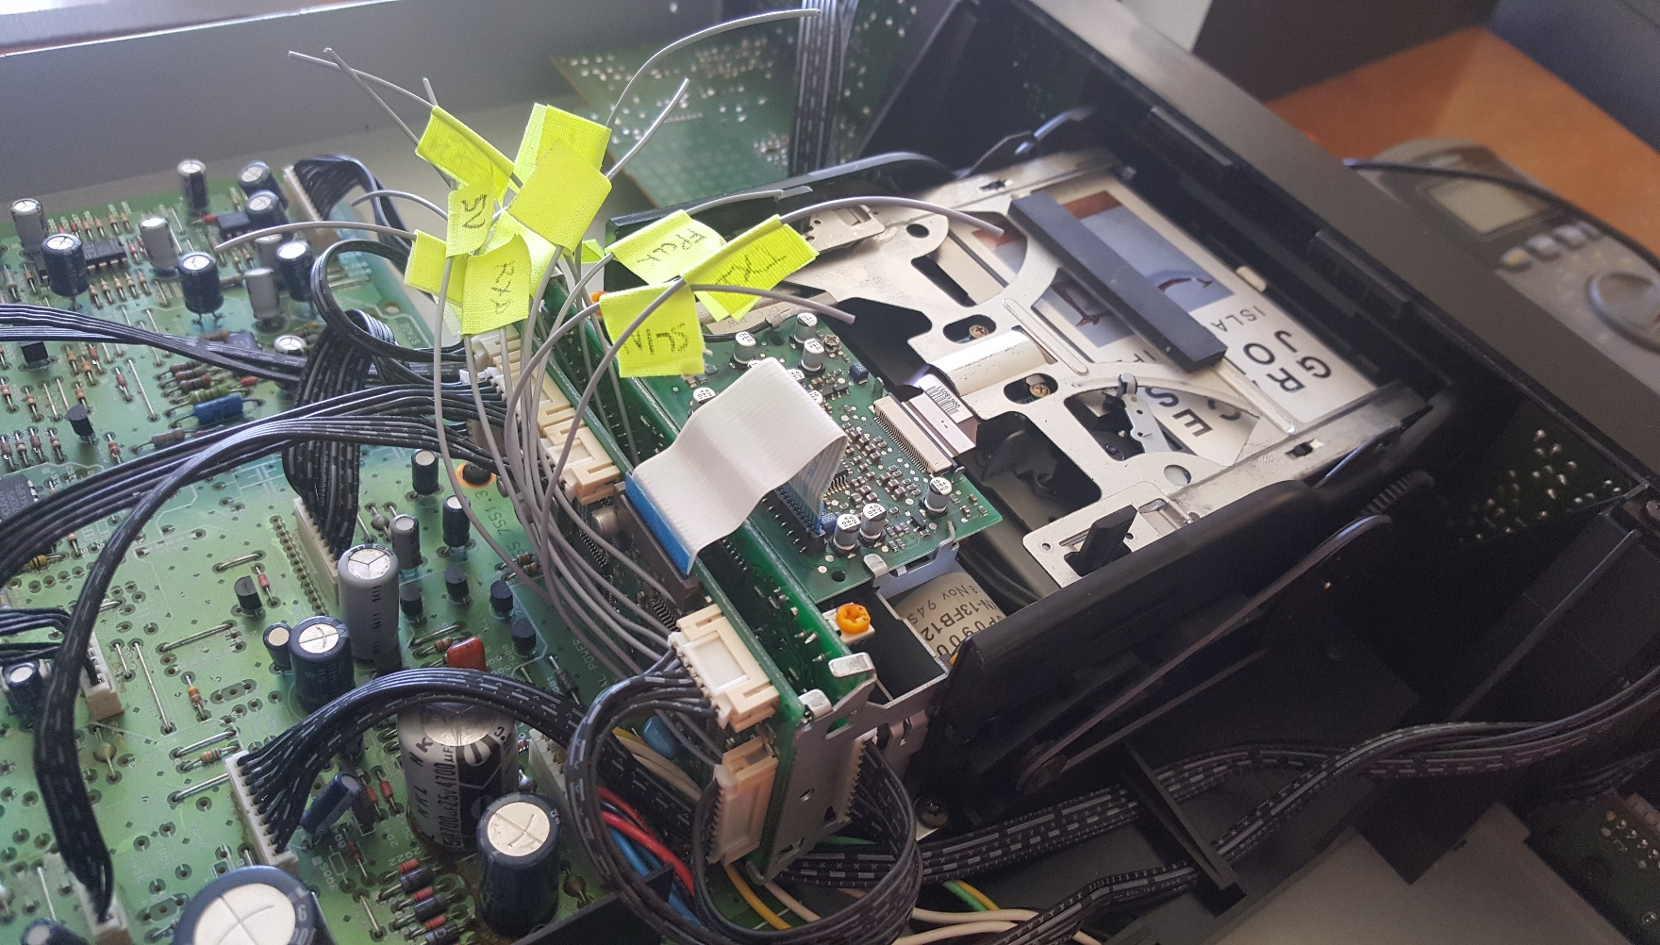
Current Status
Logic Analyzer
Service Manuals, Data Sheets

Slide 16
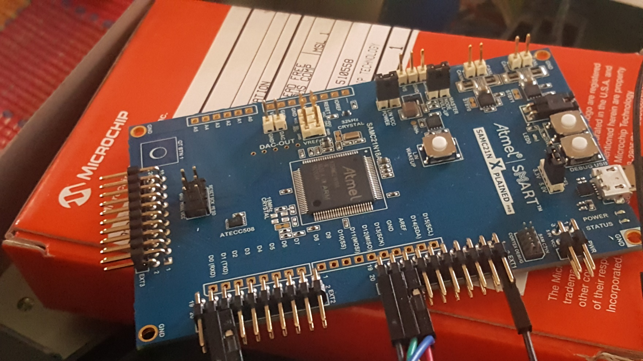
Current Status
Logic Analyzer
Service Manuals, Data Sheets
Microcontrollers

Slide 17
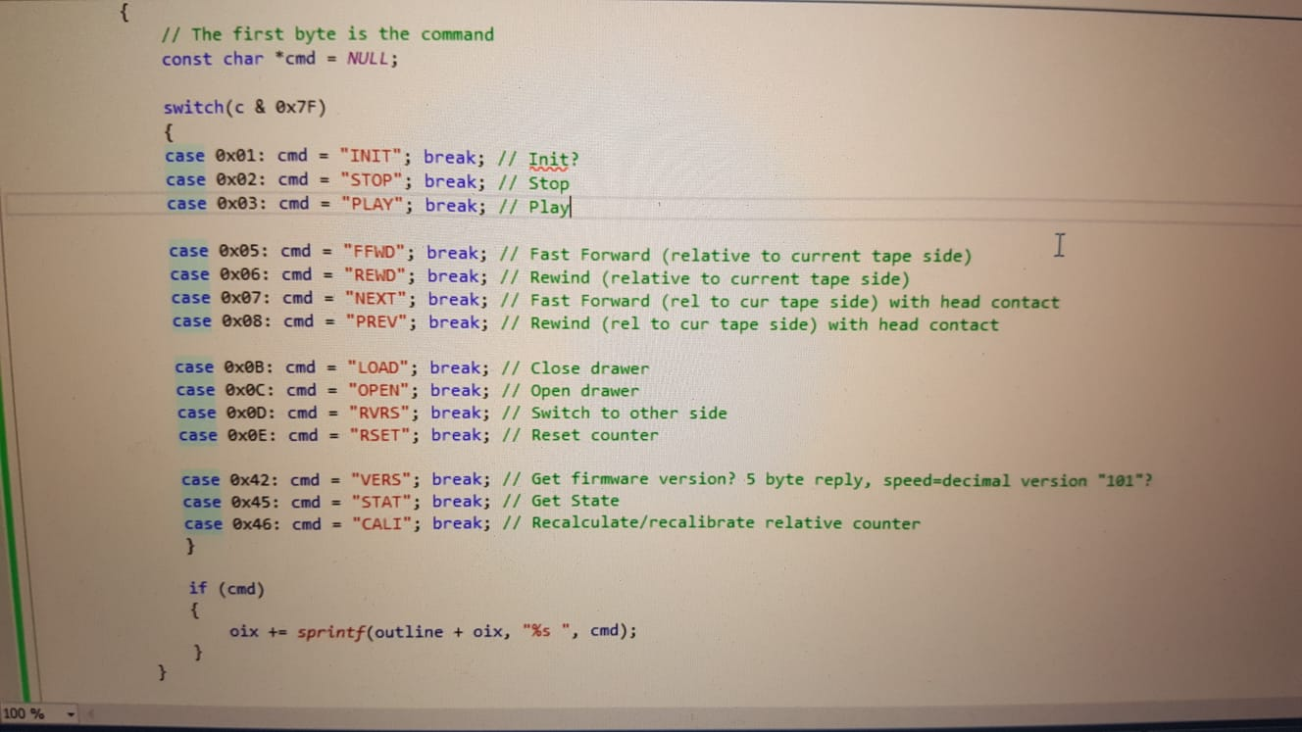
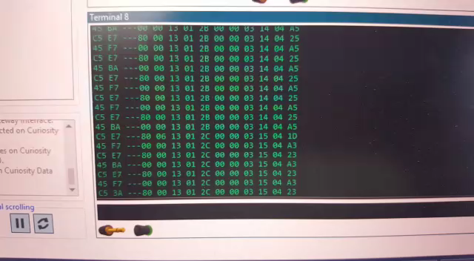
Current Status
Logic Analyzer
Service Manuals, Data Sheets
Microcontrollers
Deck Controller

Slide 18
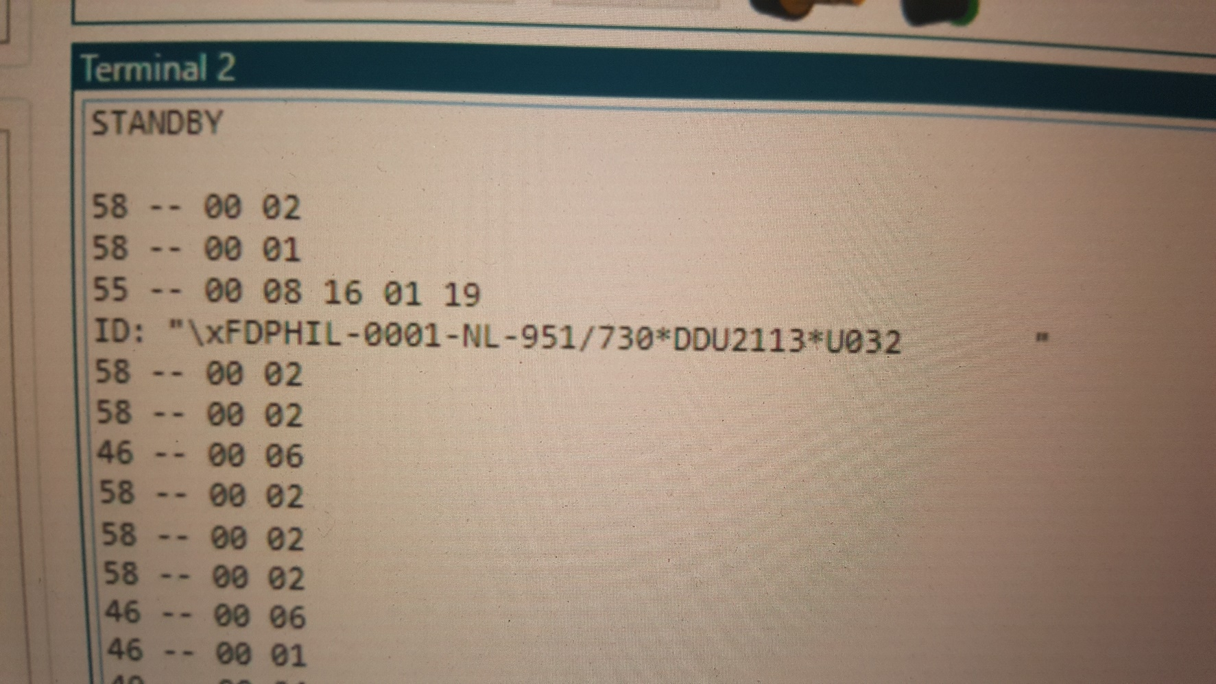
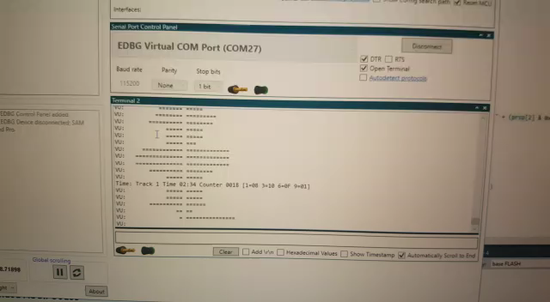
Current Status
Logic Analyzer
Service Manuals, Data Sheets
Microcontrollers
Deck Controller
Front Panel

Slide 19
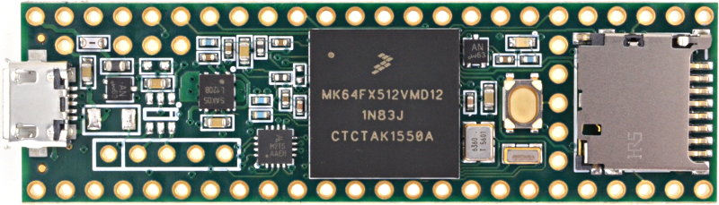
Teensy 3.5: Perfect(?) for Project “700”
Arm Cortex M4
120MHz
5V Compatible
Multiple Serial/SPI Ports
I2S Bus
SD Card
USB (Including Audio)
Perfect to Dump DCC’s

Slide 20
Future Ideas
Dump DCC’s to SD Card (Audio and Text)
Record DCC’s from SD Card
Control Multiple Decks for Series Production
Record Audio in Other Formats (MP3, Ogg Vorbis)
…

Slide 21
Conclusion
Thanks to Datasheets and Service Manuals, There Is Still Life in DCC
Project “700” for “Missing” Functionality
Additional Functionality
Heads and Tapes Will Become Problem
DCC-175 Version May Be Possible
Questions And Demo

